Slide 1
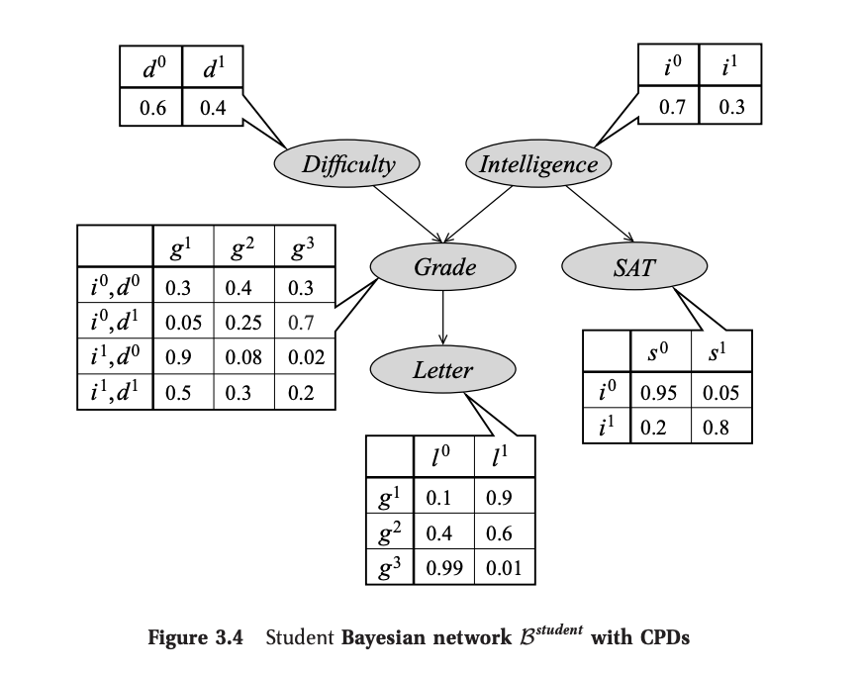
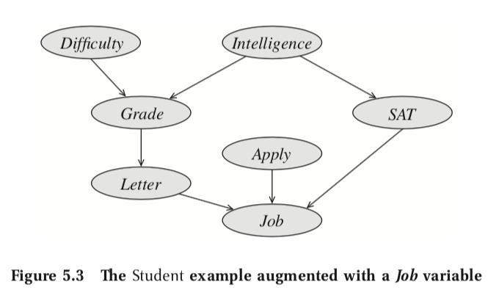
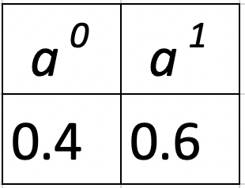
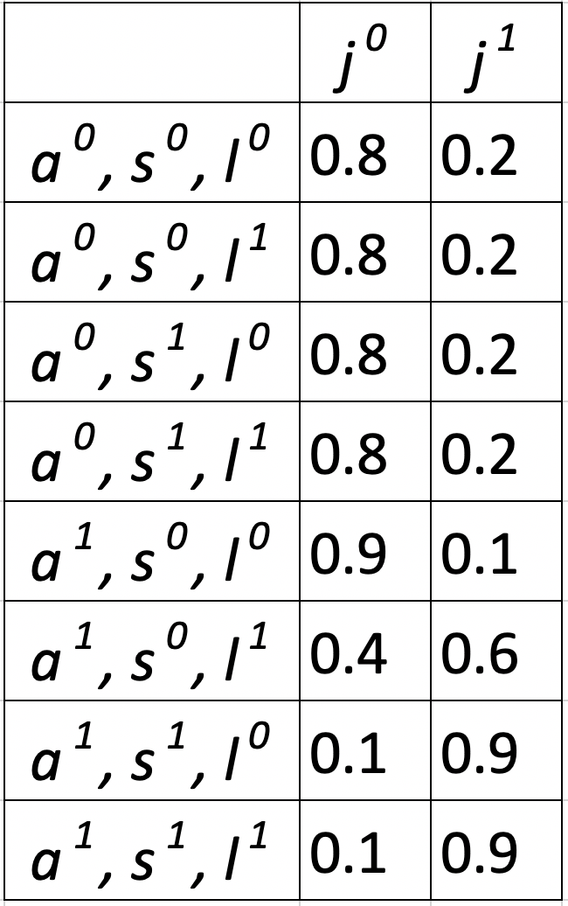
Joint Probability Inference
Explanation:
The most probable setting for all variables is:
student is not intelligent;
course is difficult;
C grade in course;
low score on SAT;
Weak letter of recommendation;
student applies for the job;
student does not get the job.
Formula:
Similarly, we have calculated joint probability for each of 192 combinations of input variables.
Notes:
Github code: https://github.com/Mihir2/Student_Bayesian_Network/blob/master/PGM-Student.ipynb
P(I,D,G,S,L,A,J) = P(I)P(D)P(G|I,D)P(S|I)P(L|G)P(A)P(J|A,S,L)
P(I,D,G,S,L,A,J) = 0.4 * 0.7 * 0.7 * 0.99 * 0.95 * 0.6 * 0.9

Slide 2
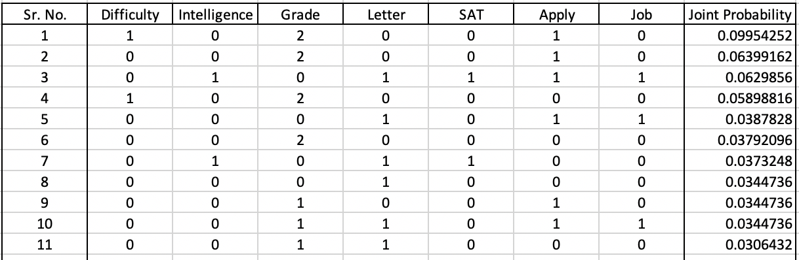
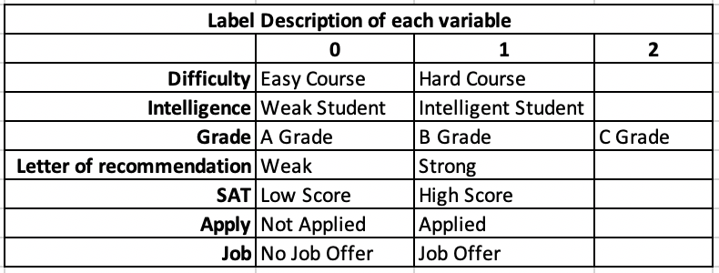
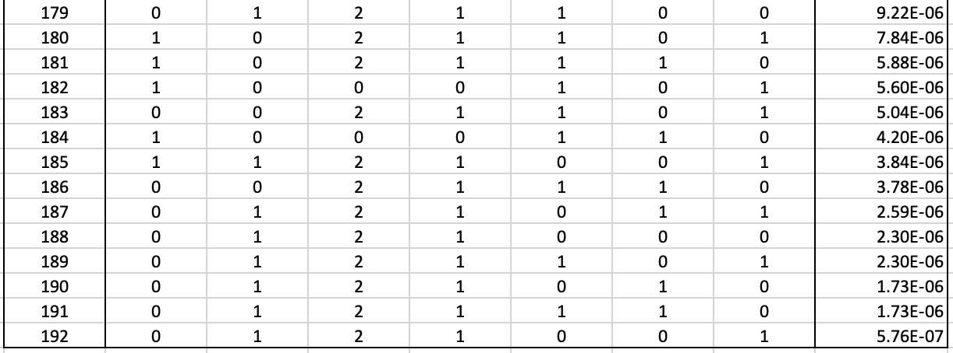
Joint Probability Inference - Combinations
most probable setting
…
…
…
Notes:
Github code: https://github.com/Mihir2/Student_Bayesian_Network/blob/master/PGM-Student.ipynb
P(I,D,G,S,L,A,J) = P(I)P(D)P(G|I,D)P(S|I)P(L|G)P(A)P(J|A,S,L)
P(I,D,G,S,L,A,J) = 0.4 * 0.7 * 0.7 * 0.99 * 0.95 * 0.6 * 0.9

Slide 3
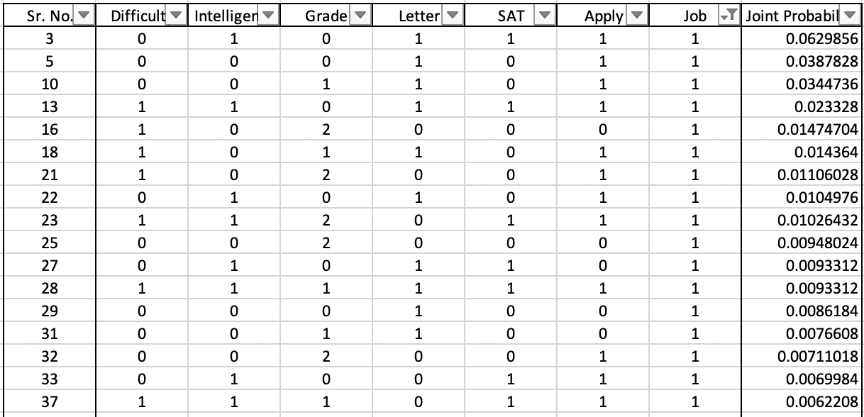
Conditional Probability MAP Inference given Job
Explanation:
The most probable explanation given student gets job is:
student is intelligent;
course is easy;
A grade;
High score on his SAT;
Strong letter of recommendation;
Applied for the job;
Formula:
Notes:
Github code: https://github.com/Mihir2/Student_Bayesian_Network/blob/master/PGM-Student.ipynb
P(I,D,G,S,L,A|J=1) = P(I,D,G,S,L,A) / P(J=1)
P(I,D,G,S,L,A,J) = P(I)P(D)P(G|D,I)P(L|G)P(S|I)P(A)P(J|A,S,L)

Slide 4
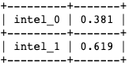
Intelligence MAP Inference given Job = 1
Explanation:
The most probable explanation given student gets job is:
student is intelligent;
Probability of Student
Intelligence
Formula:
Notes:
Github code: https://github.com/Mihir2/Student_Bayesian_Network/blob/master/PGM-Student.ipynb
P(I|J=1) = P(I) / P(J=1)
I = i_{1}, D = d_{0}, G = g_{0}, L = l_{1}, S = s_{1}, A = a_{1}, J = j_{1}
P(I = 0, J = 1) = 0.9*0.6*0.8*0.9*0.9*0.3*0.6 = 0.0629856
I = i_{0}, D = d_{0}, G = g_{0}, L = l_{1}, S = s_{0}, A = a_{1}, J = j_{1}
P(I = 1, J = 1) = 0.9*0.6*0.8*0.9*0.9*0.3*0.6 = 0.0387828
P(I = 0 | J = 1) = 0.0387/(0.0629+0.0387) = 0.381

Slide 5
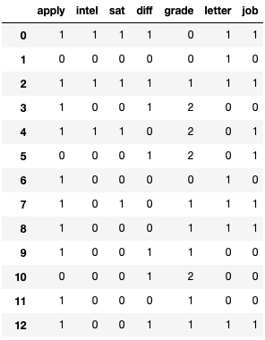
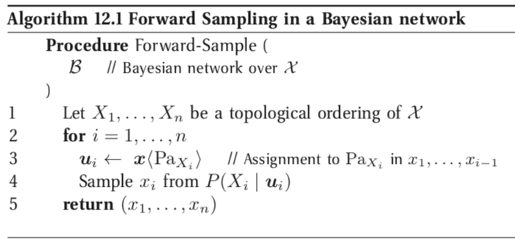
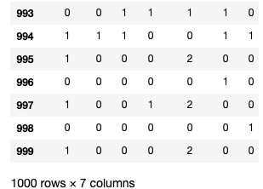
Forward Sampling from Student Bayesian Network
…
…
PGMPY:
Notes:
Github code: https://github.com/Mihir2/Student_Bayesian_Network/blob/master/PGM-Student.ipynb

Slide 6
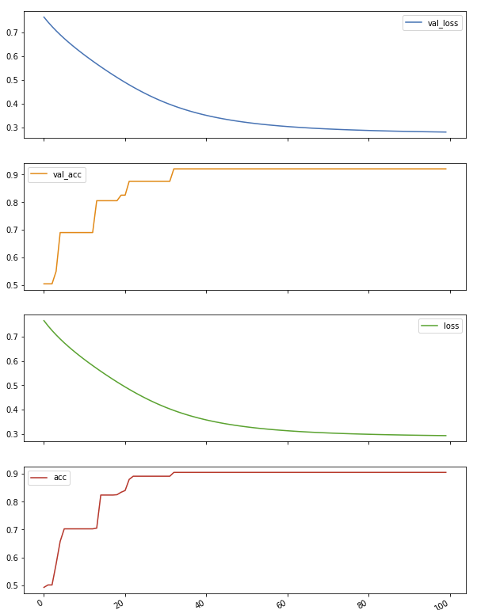
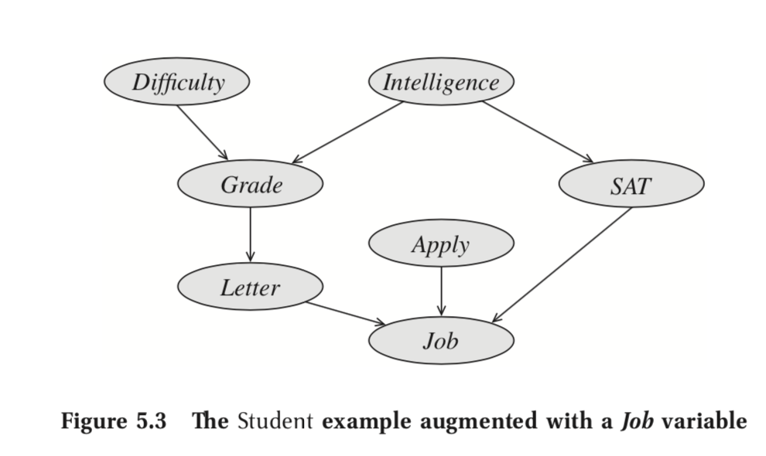
Logistic Regression over 1000 samples (Input J, S, L) (Augmented student BN)
Training Hyperparameters:
Number of Epochs: 100
Batch Size: 100
Number of samples: 1000
Number of Training samples: 800
Number of Validation samples: 200
Results:
Training Accuracy: 90.5%
Training Loss: 0.293
Testing Accuracy: 92%
Testing Loss: 0.2802
Job
Sigmoid
Activation
SAT
Intelligence
Letter
Bias
Notes:
Github code: https://github.com/Mihir2/Student_Bayesian_Network/blob/master/PGM-Student.ipynb

Slide 7
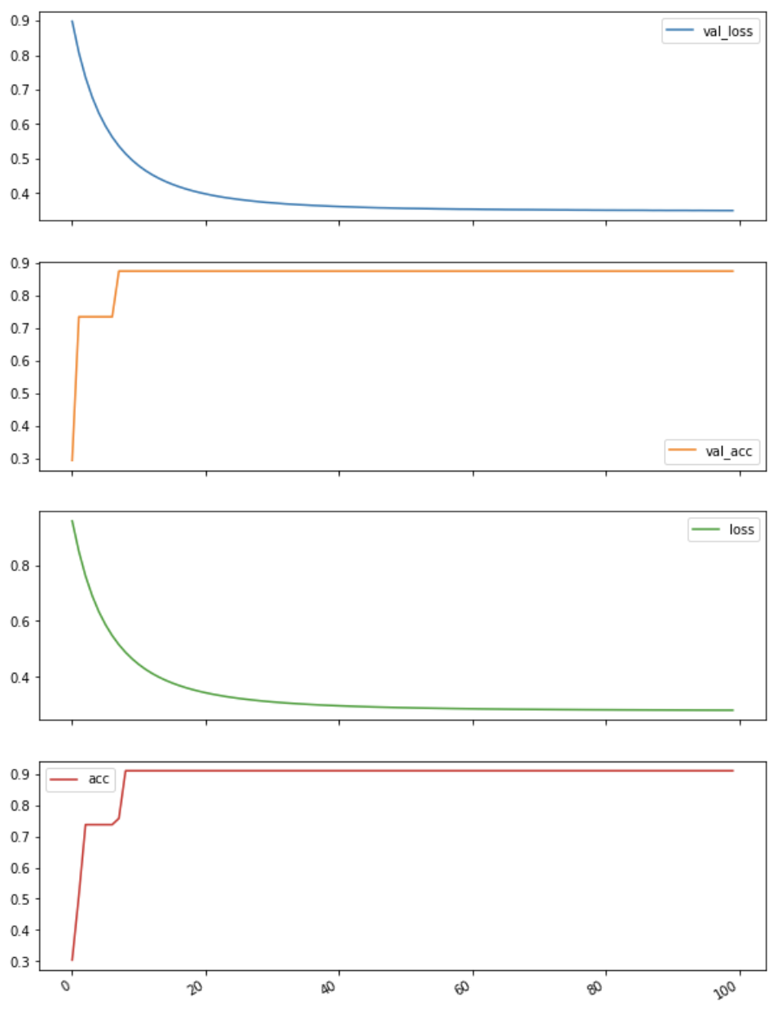
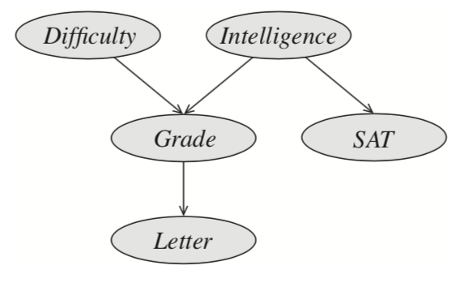
Logistic Regression over 1000 samples (Input S, L) (Unaugmented student BN)
Training Hyperparameters:
Number of Epochs: 100
Batch Size: 100
Number of samples: 1000
Number of Training samples: 800
Number of Validation samples: 200
Results:
Training Accuracy: 90.5%
Training Loss: 0.2815
Testing Accuracy: 92%
Testing Loss: 0.3494
SAT
Softmax
Activation
Letter
Intelligence
Unaugmented Student Bayesian Network
Bias
Notes:
Github code: https://github.com/Mihir2/Student_Bayesian_Network/blob/master/PGM-Student.ipynb

Slide 8
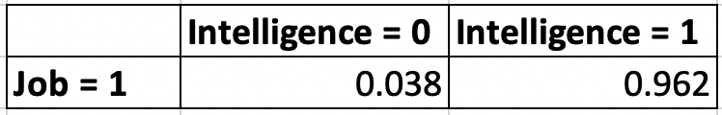
Probability of Intelligence given Job = 1 (Logistic Regression over samples from Augmented student BN)
Training Hyperparameters:
Number of Epochs: 100
Batch Size: 100
Number of samples: 1000
Number of Training samples: 800
Number of Validation samples: 200
Results:
Training Accuracy: 94.62%
Training Loss: 0.1580
Testing Accuracy: 96%
Testing Loss: 0.1534
Logistic Regression output:
Explanation:
Softmax
The most probable explanation given student gets job is:
96.2% probability that student is intelligent;
Intelligence = {0}
Job = {0, 1}
Formula:
Intelligence = {1}
Bias
Notes:
Github code: https://github.com/Mihir2/Student_Bayesian_Network/blob/master/PGM-Student.ipynb

Slide 9
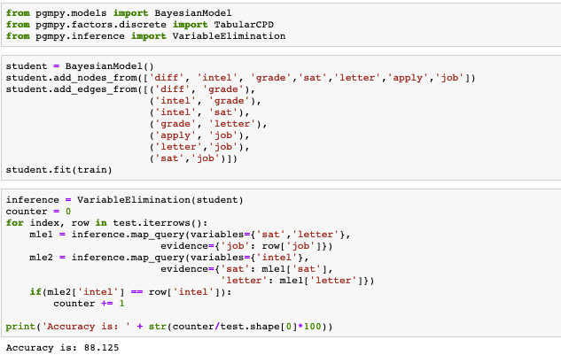
PGM classification over 1000 samples
Results:
Training Accuracy: 91.875%
Testing Accuracy: 88.125%
Notes:
Github code: https://github.com/Mihir2/Student_Bayesian_Network/blob/master/PGM-Student.ipynb

Slide 10
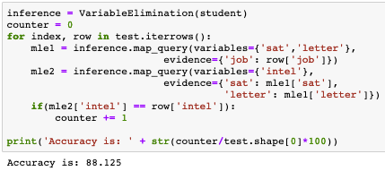
Explainable System v/s High performance system
Softmax
Intelligence = {0}
Job = {0, 1}
Intelligence = {1}
Bias
High Performance System Results:
Training Accuracy: 94.62%
Training Loss: 0.1580
Testing Loss: 0.1534
Testing Accuracy: 96%
Explainable System Results:
Training Accuracy: 91.875%
Testing Accuracy: 88.125%

Slide 11
Appendix

Slide 12
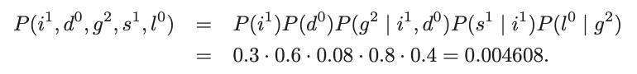
Joint Probability Inference
The probability that the
student is intelligent;
course is easy;
B in course;
high score on SAT;
gets a weak letter of recommendation
The total probability of this state is: 0.004608

Slide 13
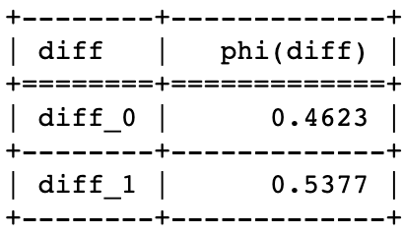
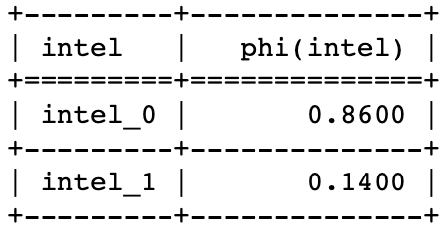
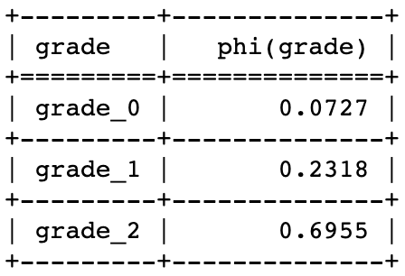
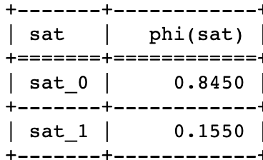
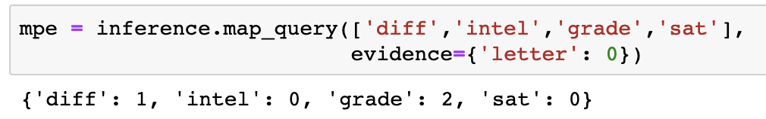
Conditional Probability Inference (MAP Query 1)
Given that professor gives a weak letter, the most probable explanation is that:
student is not intelligent;
course is difficult;
B grade in the course;
low score on SAT;
Hence, the student got a weak letter of recommendation
Probability of course Difficulty
Probability of student Intelligence
Probability of student grade
Probability of student SAT score
PGMPY:

Slide 14
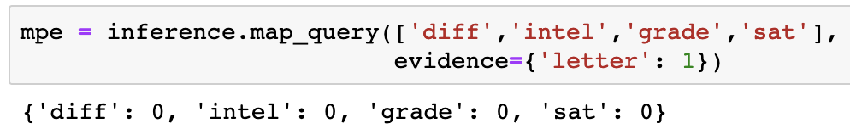
Conditional Probability Inference (MAP Query 2)
Given that professor gives a weak letter, the most probable explanation is that:
student is not intelligent;
course is easy;
high score in course;
high score on SAT;
Hence, the student got a strong letter of recommendation
Probability of course Difficulty
Probability of student Intelligence
Probability of student grade
Probability of student SAT score
PGMPY:

Slide 15
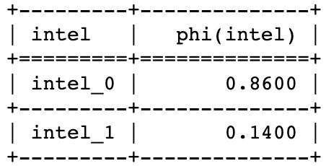
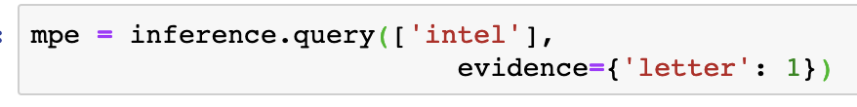
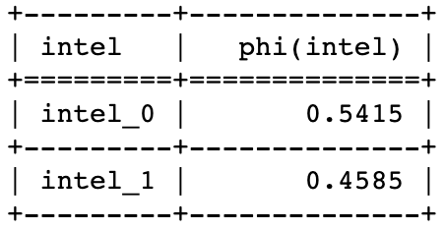
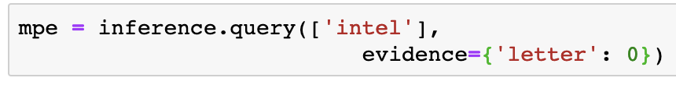
Conditional Probability Inference (MAP Query 3, 4)
Given that professor gives a weak letter or recommendation, the most probable explanation is that:
student is not intelligent;
Probability of student intelligence when recommendation is weak
Given that professor gives a strong letter of recommendation, the most probable explanation is that:
student may or may not be intelligent;
Probability of student intelligence when recommendation is strong

Slide 16
PGM for ‘AND’ Dataset with 15 Features
Is Lowercase
Dimension
Pen Pressure
Is Continuous
Size
Letter Spacing
Slantness
Tilt
Word Formation
Constancy
Staff of d
Entry Stroke a
Exit Stroke d
Staff of a
Formation of n

Slide 17
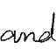
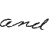
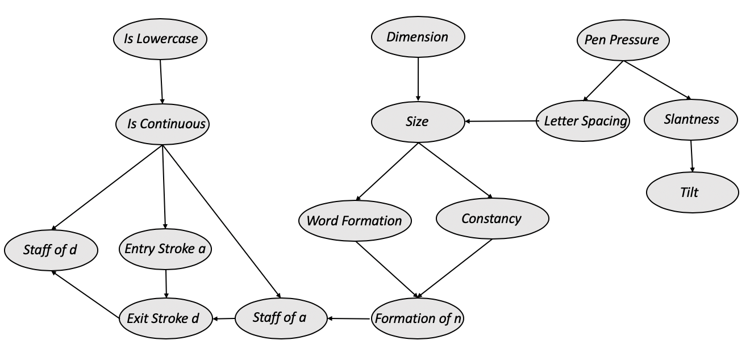
PGM Handwriting Verification
Questioned handwritten “AND” Sample
Known handwritten “AND” Sample
Results:
Training Accuracy: -- %
Testing Accuracy: --%
Verifier node

Slide 18
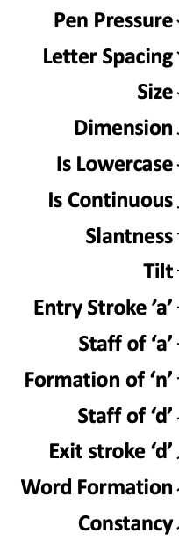
Logistic Regression for Handwriting Verification
Softmax
Questioned handwritten “AND” Sample
Same Writer
Different Writer
Known handwritten “AND” Sample
Results:
Training Accuracy: -- %
Training Loss: --
Testing Loss: --
Testing Accuracy: --%
Formation of n

Slide 19
Neural Network with 1 hidden layer
h11
Questioned handwritten “AND” Sample
h12
Same Writer
h13
Different Writer
Known handwritten “AND” Sample
Results:
Training Accuracy: -- %
Training Loss: --
Testing Loss: --
Testing Accuracy: --%
h14

Slide 20
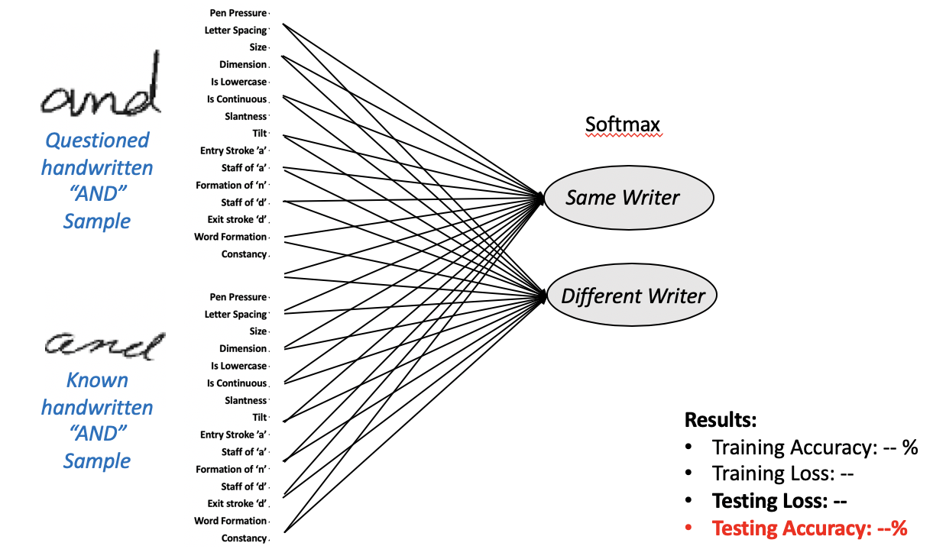
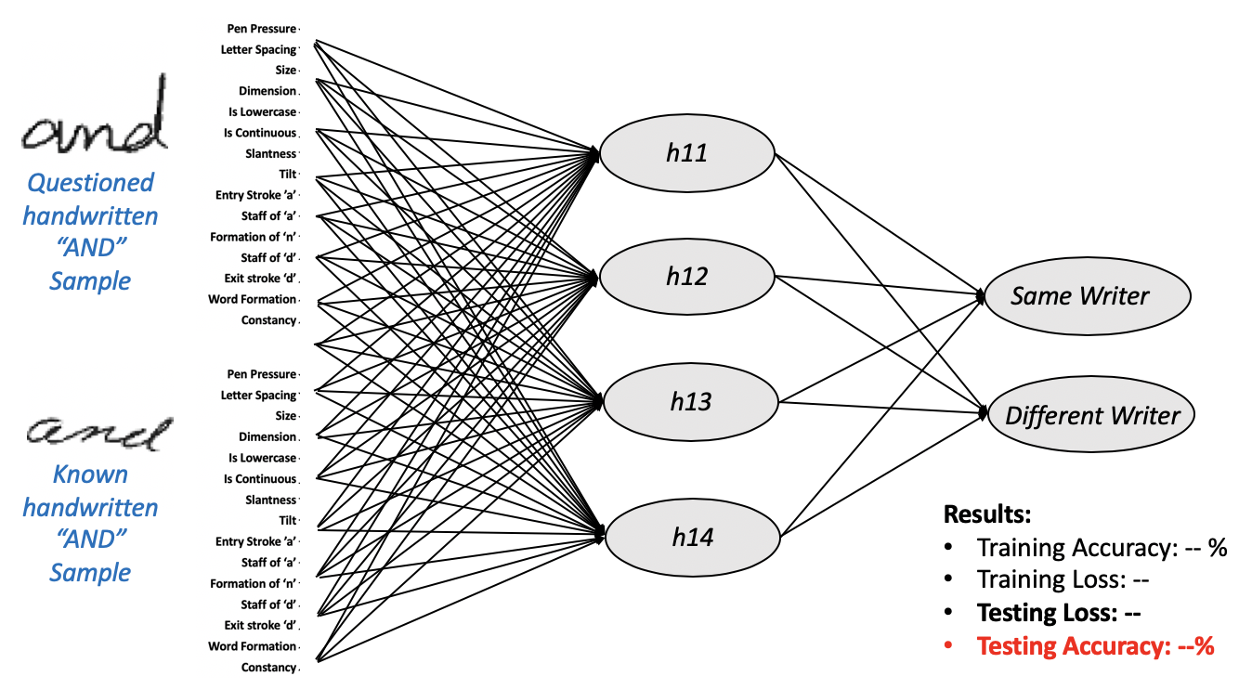
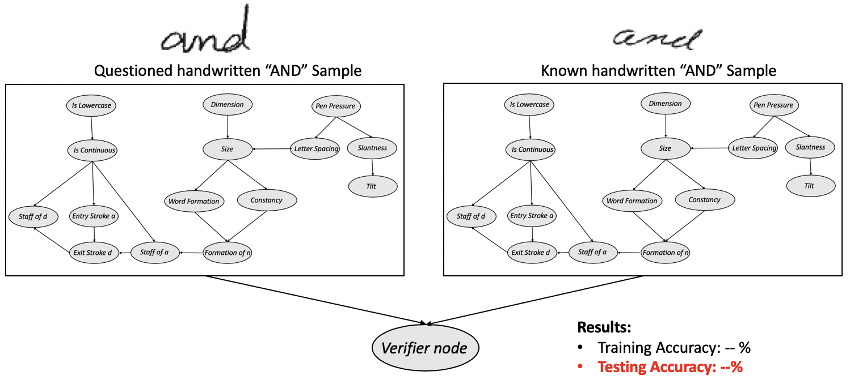
Explainable System v/s High performance system
Explainable System Results:
Training Accuracy: --%
Testing Accuracy: --%
High Performance System (LR)
Training Accuracy: --%
Training Loss: --
Testing Loss: --
Testing Accuracy: --%
Very High Performance System (NN)
Training Accuracy: --%
Training Loss: --
Testing Loss: --
Testing Accuracy: --%

